Slide 1
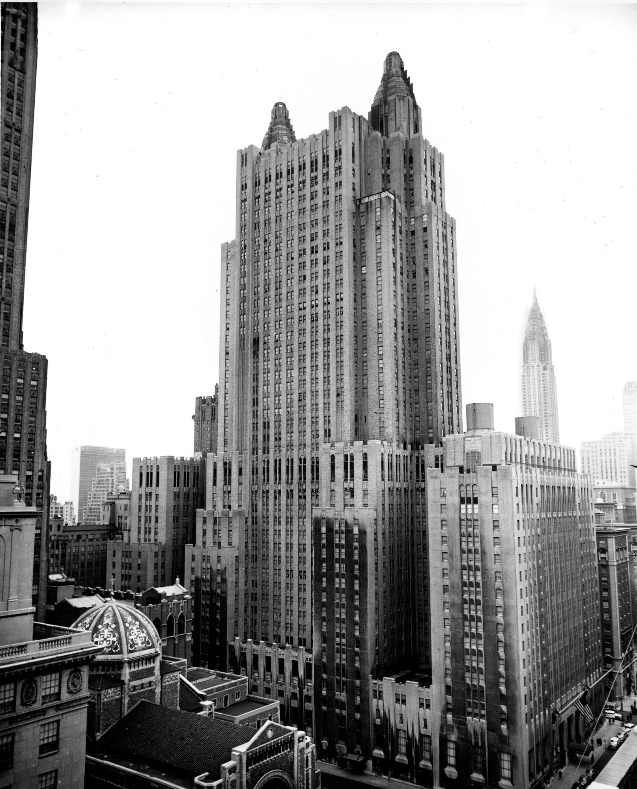
The Waldorf Astoria Hotel
1931
The Schultze & Weaver firm
301 Park Avenue Manhattan, New York City NY

Slide 3
Solid
Proud
Regular
Grand
Strong
Rigid
Ordered
Commanding

Slide 4
Rules
4
1
2
3
5
4’s will be the top row on a stack of 5’s in between a pair of 1’s
5’s that do not reside within a pair of 1’s do not have 4’s but will still be placed evenly and linearly
2’s will be between stacks of 5’s that are capped by 4’s, each being parallel to each other
Columns of 5’s topped by 4’s will occur at odd intervals
1’s must always point with ‘up’, all oriented in the same direction
Stacks of 5’s whether or not they are topped by 5’s should be centered between 2’s/1’s or within 1’s

Slide 7
Like an open-air temple, a shrine, whether it be to deity or monster shall be great in stature and open enough to exaggerate its form. To be in the presence of a space so large and yet feel so confined and small compared to it leaves on in awe and demands respect for that place. This grammar, being orderly, neat, and inherently balanced/symmetric makes it easy to create a strong base, a structure which will last; the ruins of which will still show that something great once stood. They should not just be tall but beckon you to crane your neck upwards and keep it there as you feel so small, so honored, to behold it. This beacon, this landmark, has been built with purpose, and that is what permits it to stand.

